Slide 1

8th Grade Math: Pre-Algebra
Unit 12, Lesson 4 Factoring Expressions Volume 2, pg.230

Slide 2


Benchmark
MA.8.AR.1.3
Rewrite the sum of two algebraic expressions having a common monomial factor as a common factor multiplied by the sum of two algebraic expressions.
volume 2, pg. 230

Slide 3
Integrated Mathematical Thinking and Reasoning Standards
MA.K12.MTR.1.1 Actively participate in effortful learning both individually and collectively.
MA.K12.MTR.2.1 Demonstrate understanding by representing problems in multiple ways.
MA.K12.MTR.3.1 Complete tasks with mathematical fluency.
MA.K12.MTR.5.1 Use patterns and structure to help understand and connect mathematical concepts.
volume 2, pg. 230

Slide 4

Learning Target
I can rewrite an algebraic expression with a common factor using the distributive property.
volume 2, pg. 230

Slide 5

Warm-Up
volume 2, pg. 230

Slide 6
12.4.1 Warm-Up: Number Puzzle
Solve the puzzle by filling in each blank cell. The values in the blue box represent the products of the values at the end of each row and column.
volume 2, pg. 230

Slide 7

Refresher
volume 2, pg. 231

Slide 8


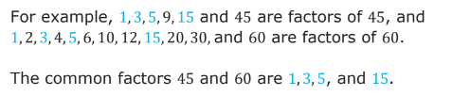

12.4.2 Refresher: Common Factors
In multiplication expressions, the numbers being multiplied are called factors and the result is called the product.
Numbers can have common factors.
A common factor of two numbers is a factor that they both share.
The greatest common factor (GCF) of two or more whole numbers is the largest whole number that evenly divides the given whole numbers.
For example, $15$ is the greatest common factor for $45$ and $60$.
volume 2, pg. 231

Slide 9
For the number pairs in the table, list the common factors. Then, identify the GCF.
Common factors can be used to rewrite numeric expressions.
volume 2, pg. 231

Slide 10
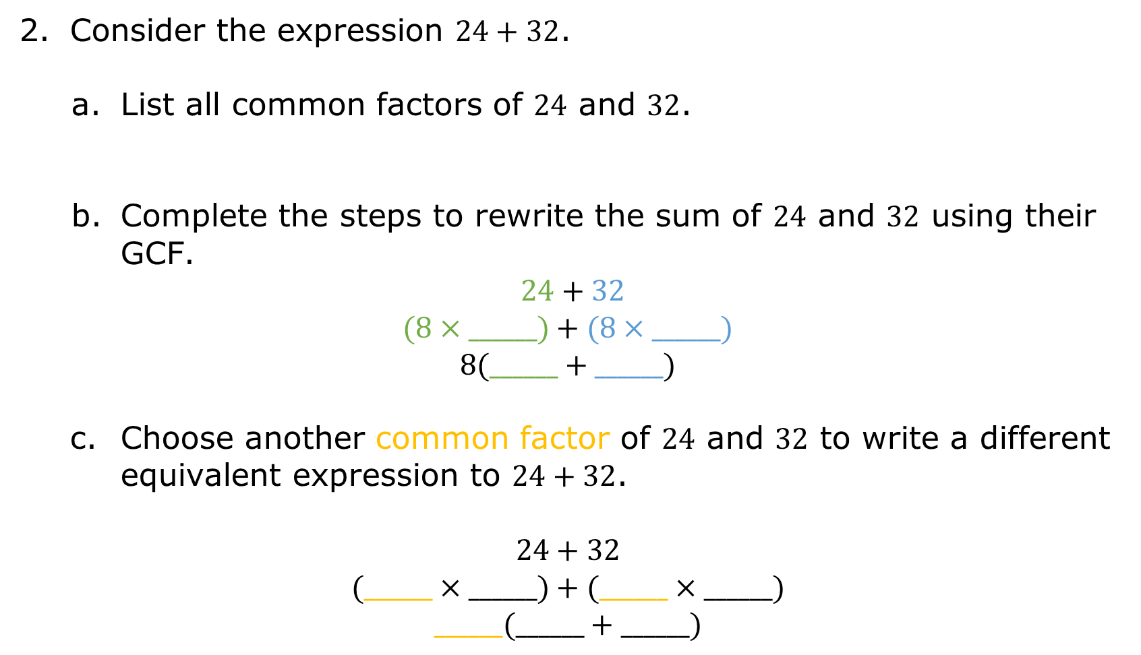
Consider the expression $24+32$.
List all common factors of $24$ and $32$.
Complete the steps to rewrite the sum of $24$ and $32$ using their GCF.
$24+32$
$$(8×______)+(8×______)$$
$$8(______+______)$$
Choose another common factor of $24$ and $32$ to write a different equivalent expression to $24+32$.
$$24+32$$
$$(______×______)+(______×______)$$
$$______(______+______)$$
volume 2, pg. 231

Slide 11

Activity
volume 2, pg. 232

Slide 12

12.4.3 Activity: Card Sort
Six numeric expressions are shown. Work with your partner to find at least one equivalent expression for each. Expressions may have one, two, or three matches.
Record the letter(s) of the equivalent expressions in the space provided under each expression.
volume 2, pg. 232

Slide 13
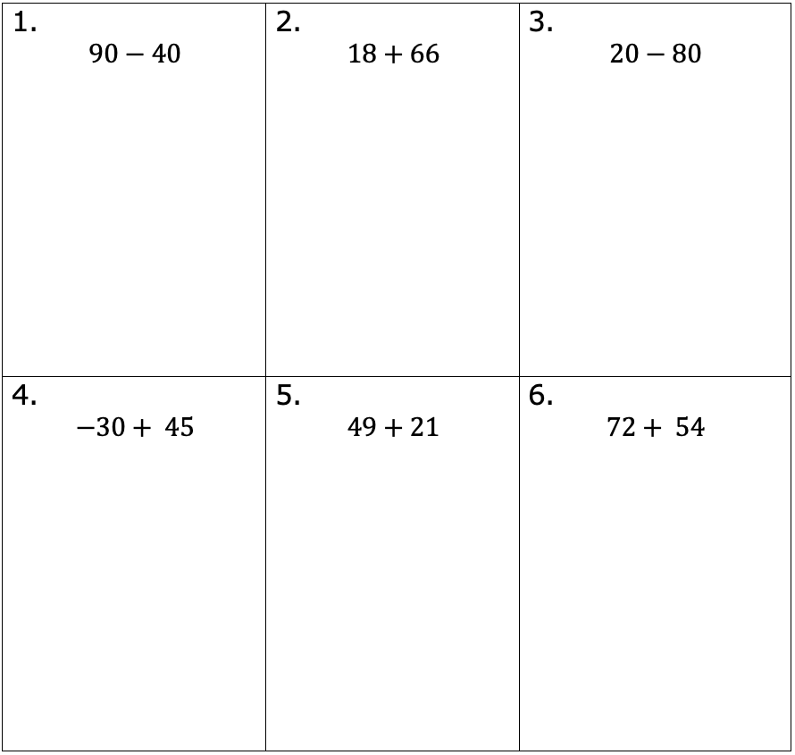
volume 2, pg. 232

Slide 14

Exploration
volume 2, pg. 232

Slide 15

12.4.4 Exploration: Equivalent Forms of Algebraic Expressions
Common factors can also be used to rewrite algebraic expressions.
Use your understanding of common factors to complete the area models shown.
volume 2, pg. 232

Slide 16
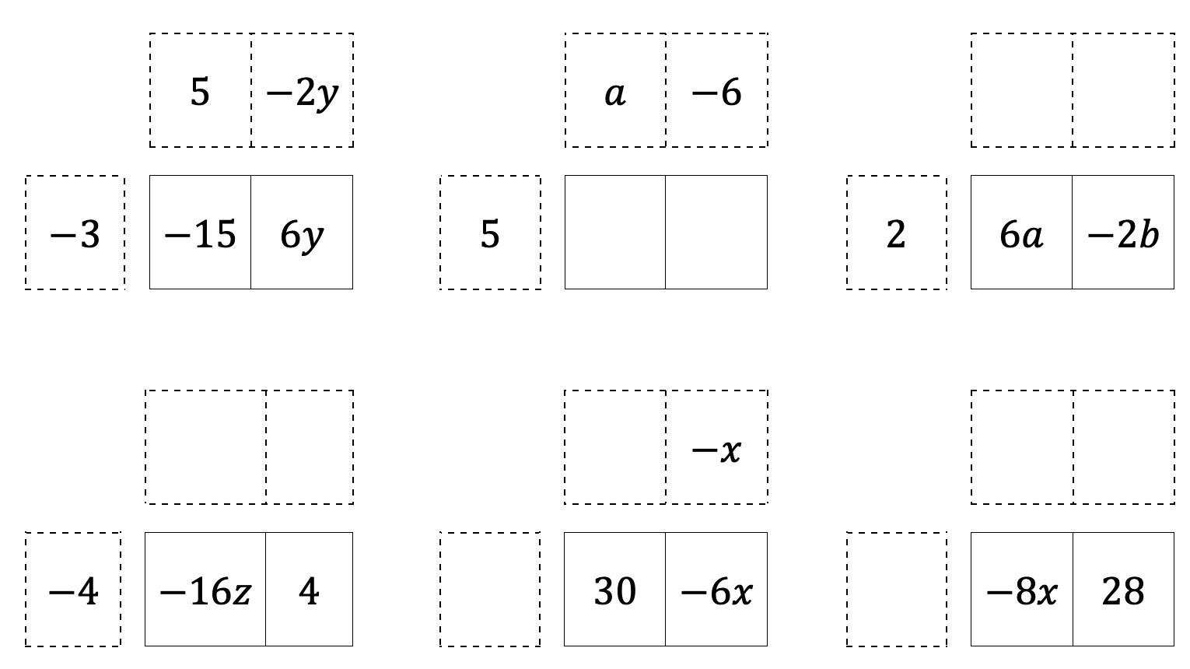
volume 2, pg. 232

Slide 17
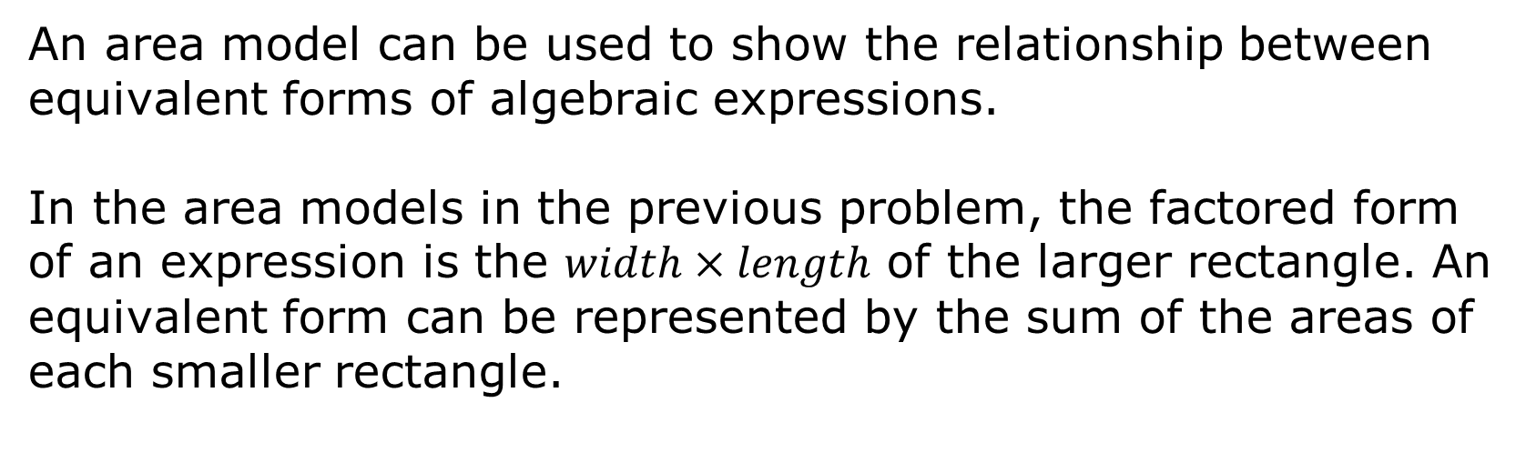
An area model can be used to show the relationship between equivalent forms of algebraic expressions.
In the area models in the previous problem, the factored form of an expression is the $width×length$ of the larger rectangle. An equivalent form can be represented by the sum of the areas of each smaller rectangle.
volume 2, pg. 233

Slide 18
Complete the table using the area models from the previous problem.
volume 2, pg. 233

Slide 19
Compare your work with your partner. Discuss any differences and make any corrections as needed.
Work with your partner to complete the following.
Without using area models, complete the table.
volume 2, pg. 233

Slide 20
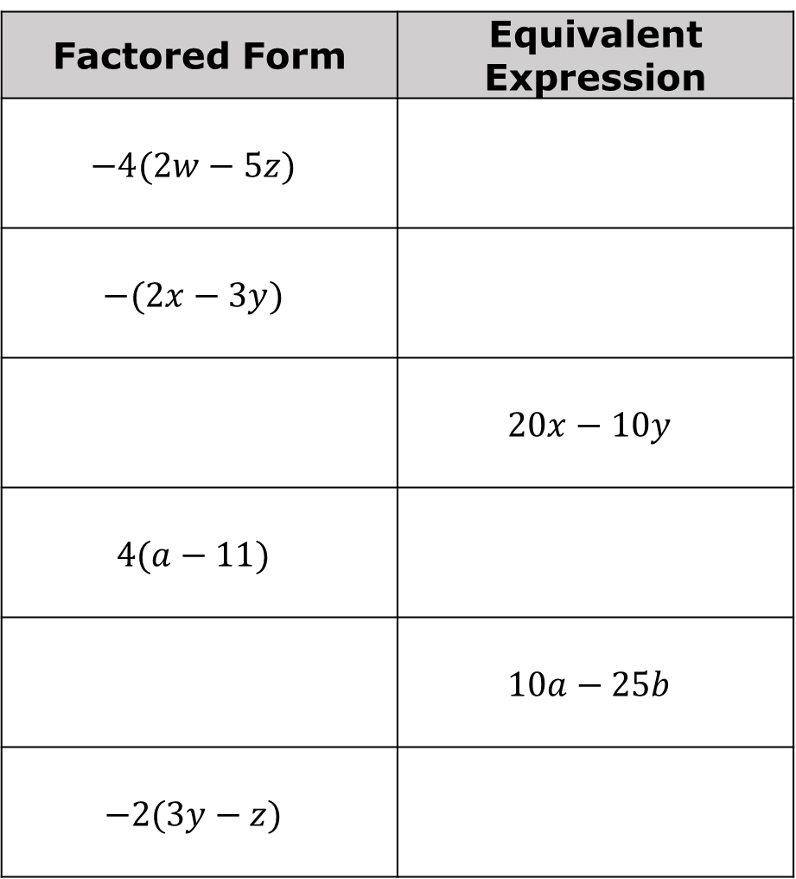
Factored Form | Equivalent Expression
$$−4(2w−5z)$$
$$−(2x−3y)$$
 | $$20x−10y$$
$$4(a−11)$$
 | $$10a−25b$$
$$−2(3y−z)$$
volume 2, pg. 233

Slide 21
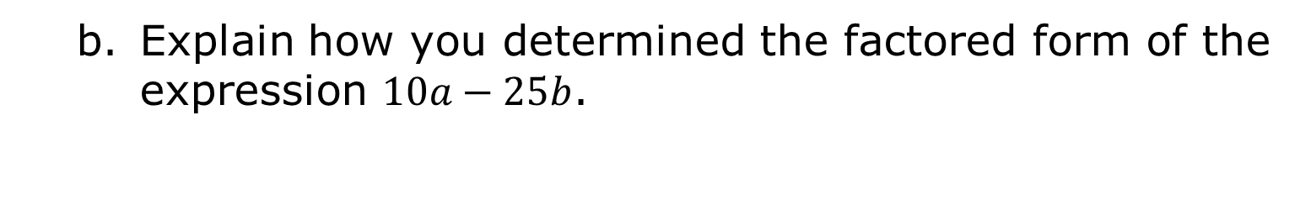
Explain how you determined the factored form of the expression $10a−25b$.
volume 2, pg. 233

Slide 22
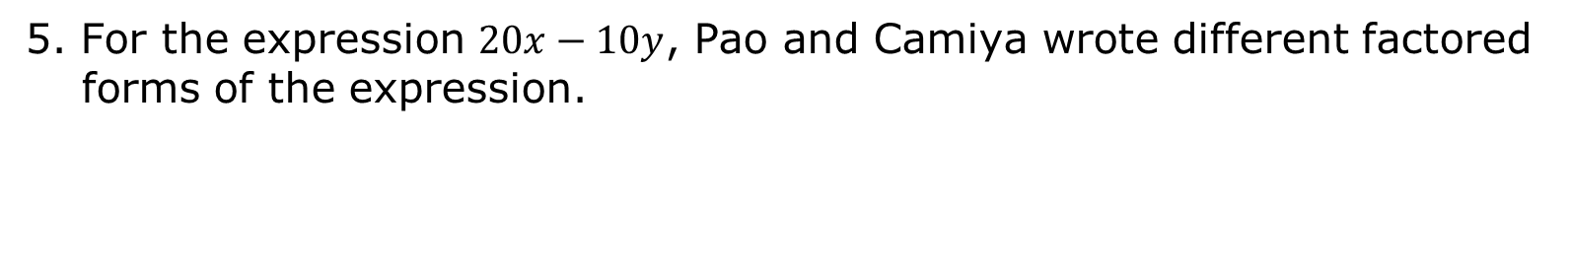
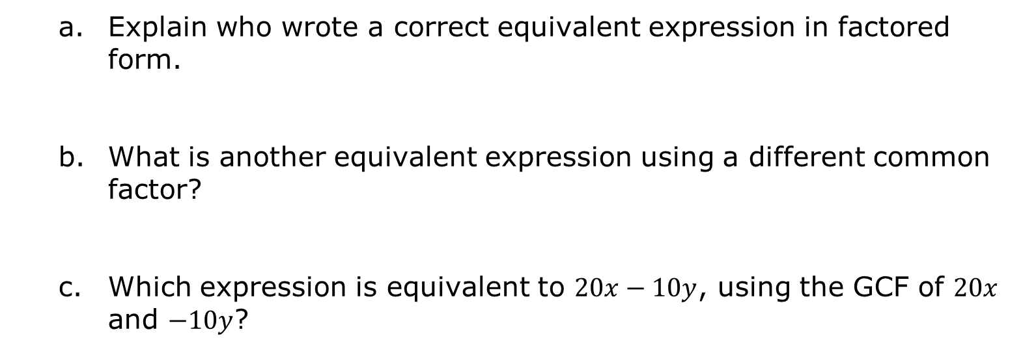
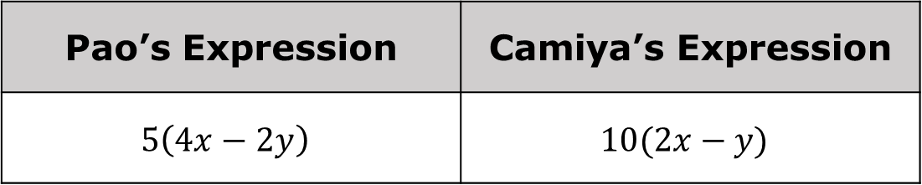
5. For the expression $20x−10y$, Pao and Camiya wrote different factored forms of the expression.
Pao’s Expression | Camiya’s Expression
$$5\left(4x−2y\right)$$ | $$10(2x−y)$$
Explain who wrote a correct equivalent expression in factored form.
What is another equivalent expression using a different common factor?
Which expression is equivalent to $20x−10y$, using the GCF of $20x$ and $−10y$?
volume 2, pg. 234

Slide 23

Bring It Together
volume 2, pg. 234

Slide 24

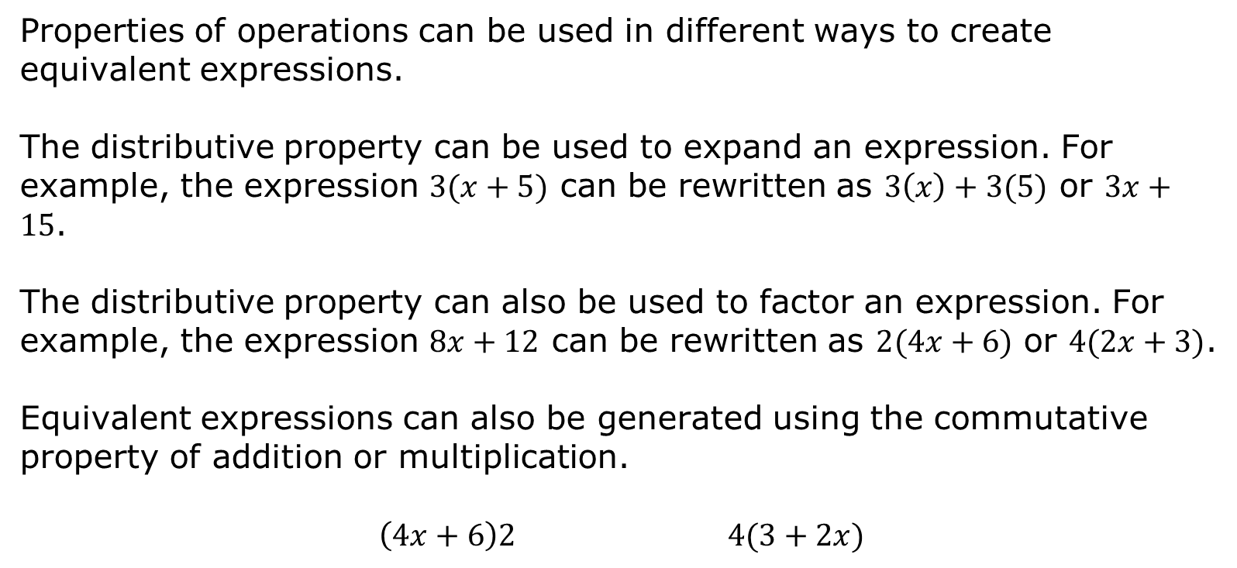
12.4.5 Bring It Together: Factoring Expressions
Properties of operations can be used in different ways to create equivalent expressions.
The distributive property can be used to expand an expression. For example, the expression $3(x+5)$ can be rewritten as $3\left(x\right)+3(5)$ or $3x+15$.
The distributive property can also be used to factor an expression. For example, the expression $8x+12$ can be rewritten as $2(4x+6)$ or $4(2x+3)$.
Equivalent expressions can also be generated using the commutative property of addition or multiplication.
$\left(4x+6\right)2$ $4(3+2x)$
volume 2, pg. 234

Slide 25
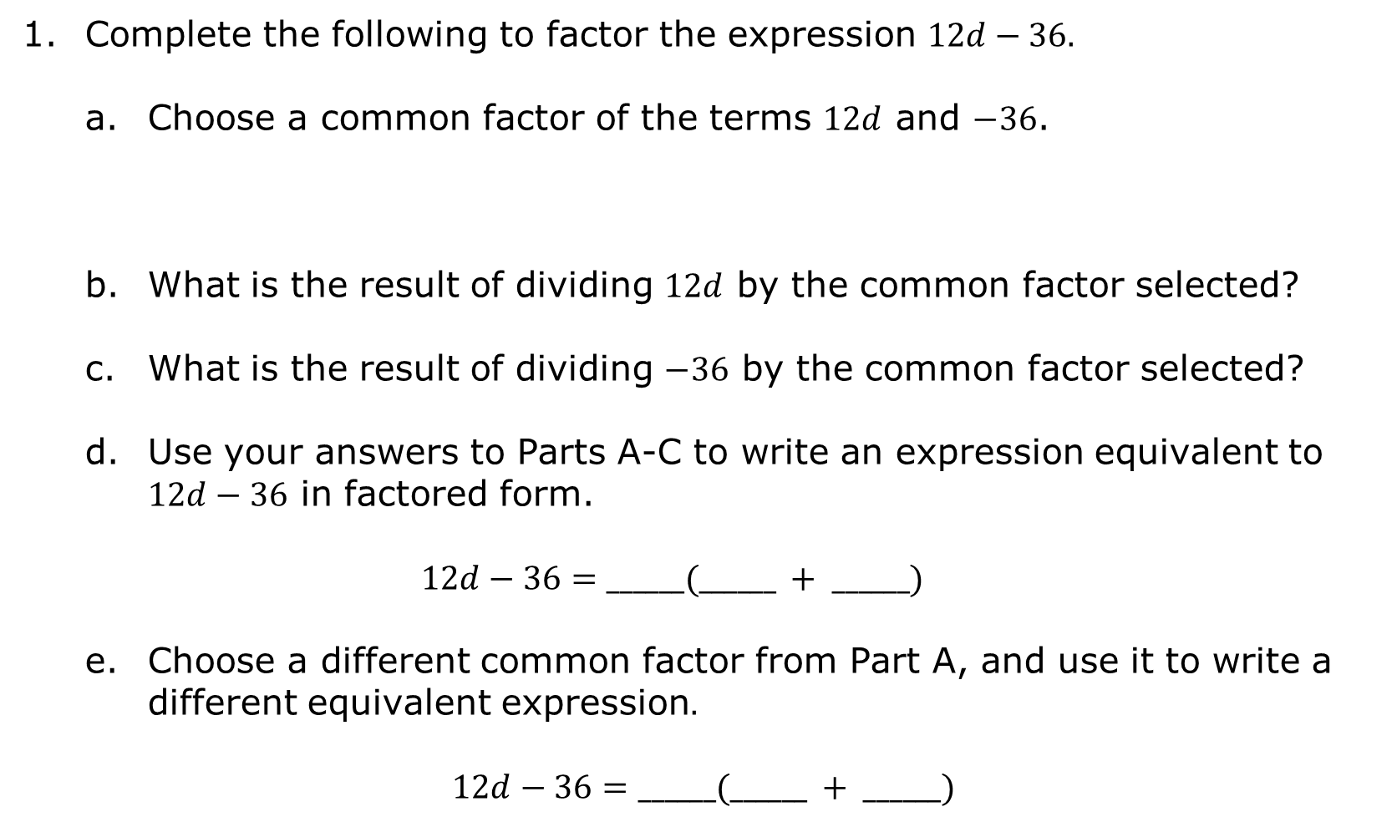
Complete the following to factor the expression $12d−36.$
Choose a common factor of the terms $12d$ and $−36$.
What is the result of dividing $12d$ by the common factor selected?
What is the result of dividing $−36$ by the common factor selected?
Use your answers to Parts A-C to write an expression equivalent to $12d−36$ in factored form.
$$12d−36=______(______ + ______)$$
Choose a different common factor from Part A, and use it to write a different equivalent expression$.$
$$12d−36=______(______ + ______)$$
volume 2, pg. 234

Slide 26
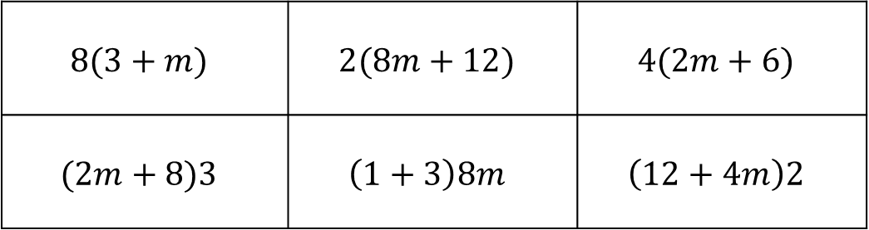
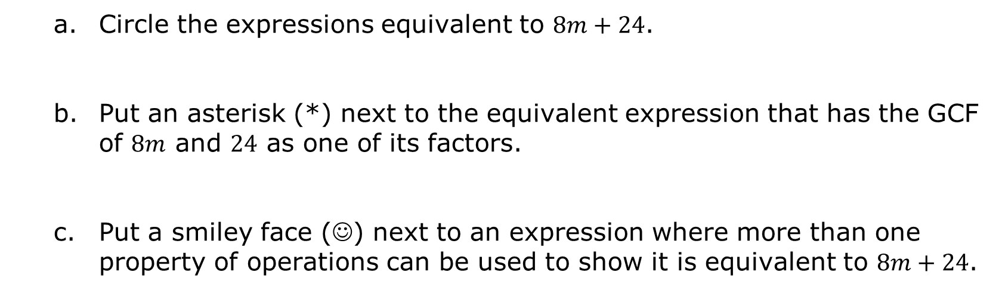
Several expressions are shown.
$$8(3+m)$$ | $$2(8m+12)$$ | $$4(2m+6)$$
$$(2m+8)3$$ | $$\left(1+3\right)8m$$ | $$\left(12+4m\right)2$$
Circle the expressions equivalent to $8m+24$.
Put an asterisk (*) next to the equivalent expression that has the GCF of $8m$ and $24$ as one of its factors.
Put a smiley face (☺) next to an expression where more than one property of operations can be used to show it is equivalent to $8m+24$.
volume 2, pg. 235

Slide 27

Try It
volume 2, pg. 235

Slide 28


12.4.6 Try It: Factoring Expressions
Rewrite each expression in an equivalent factored form.
$−15z+20=$
$4x−32=$
$−27−12d=$
$35f+28g=$
volume 2, pg. 235

Slide 29
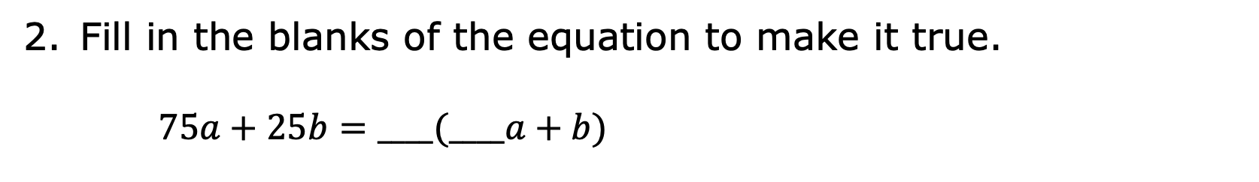
Fill in the blanks of the equation to make it true.
$75a+25b=____(____a+b)$
volume 2, pg. 235

Slide 30

Wrap-Up
volume 2, pg. 236

Slide 31
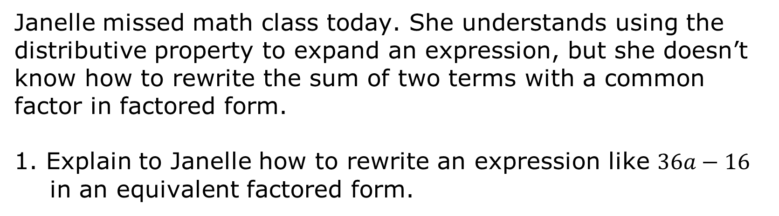
12.4.7 Wrap-Up: Cool Down
Janelle missed math class today. She understands using the distributive property to expand an expression, but she doesn’t know how to rewrite the sum of two terms with a common factor in factored form.
1. Explain to Janelle how to rewrite an expression like $36a−16$ in an equivalent factored form.
volume 2, pg. 236

